Slide 1
Eye Care Transformation Programme briefing
June 2022
For more information contact b.reis-seymour@nhs.net

Slide 2
Eye Care Transformation Programme - summary
The health and care system in Shropshire, Telford and Wrekin is planning to transform local eye-care services.
The aim is to provide effective eye-care services that are more joined up so that adults and children get the best care possible when and where they need it.
We want to improve the experience of patients and staff working in eye-care services by looking at the way people access care, how they manage their eye conditions, and how the services work together, share information, and provide good patient care.
Insight gathered through early engagement with the public and clinicians is helping to shape the future model of care.
Key areas of work that will be included in the eye-care transformation programme are:
Referrals processes
Outpatients’ transformation
Integrated pathways across Primary/Community/Secondary eye-care and links with social care
Multi-Speciality pathways
Areas of work not included in the programme:
Ophthalmology Surgery
Eye related Cancer Care
Identify areas of focus and recommendations based on the engagement insight
Share the report with the design group to inform design and development of future eye-care services
Publish the engagement report and summary to share with those engaged and wider stakeholders including an update on next steps
Ongoing communication and engagement, including engagement on any new proposals

Slide 3
Reasons for change
To anticipate the increasing need for services
To reduce unnecessary face to face outpatient appointments
To enhance the early detection and prevention of eye related conditions
To provide more joined up services across primary, secondary and community care
To provide more services closer to home, when its needed
To make better use of new technologies and developments in eye care
To make better use of available data and be able to track people’s care

Slide 4
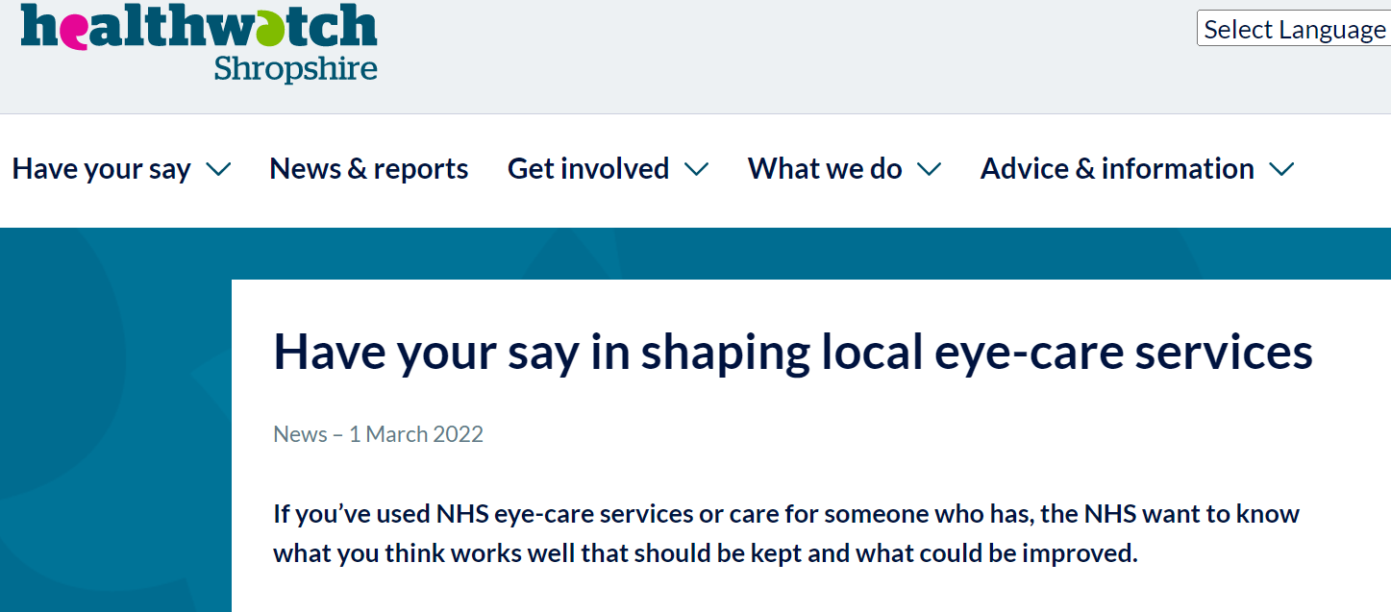
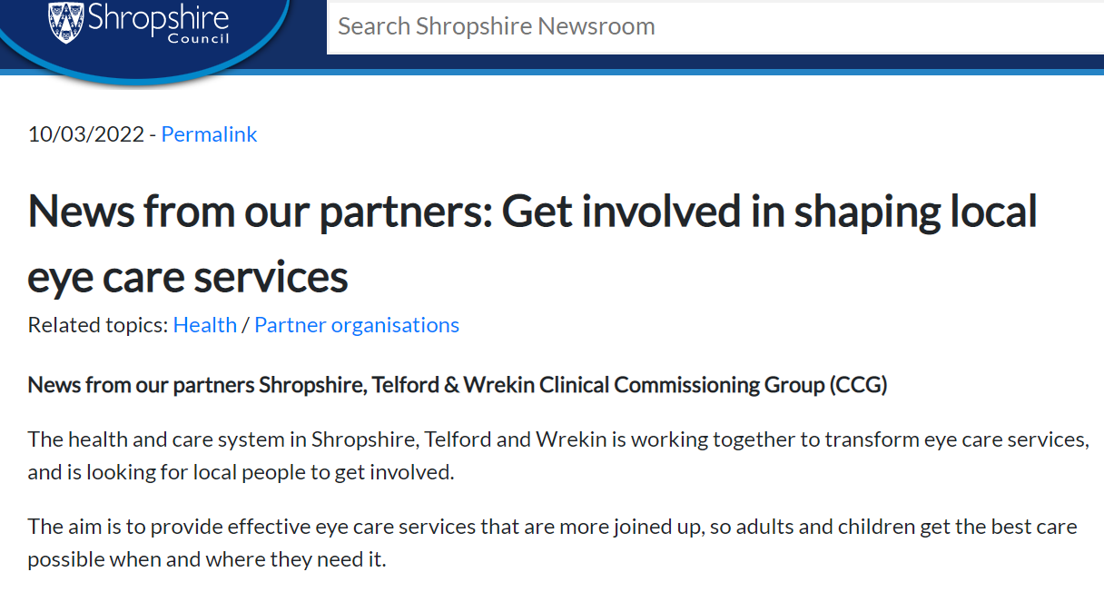
Early Engagement
April 2021
262 responses to our survey
Outreach sessions within eye care clinics
Engagement workshops with the public, NHS providers and independent providers
Community outreach engagement
May 221
July 2021
Sept 2021
Nov 2021
Dec 2021
2022 +
2021 - 22

Slide 5
What we heard: what works well
A good standard of care
Clinical Stakeholders | The clinical care which is provided is of a good standard, staff are engaged and there is a good level of trust between the optometrist and the patient.
Patient and Public | Patients value the detail they are given about their condition, which gives confidence that they have been correctly diagnosed.
Independent Sector | Open and honest communication leads to the patient becoming an advocate of the service.
Collaborative and Accessible
Clinical Stakeholders | Offering patient choice works well, collaborative working with the independent sector and the ability to share images all helps to improve the patient experience and ensure they are seen in a timely manner.
Patient and Public | Patients tell us that there are direct links between their local optician and the hospital and that when the process works, patients find they are seen quickly and flexibly. They find many of our facilities are suitable for them to access and navigate around.
Independent Sector | Collaboration between the independent sector and secondary care is important and is assisted by regular meetings with clinicians and operational leads working together, feedback loop between independent sector providers and hospital is key

Slide 6
What we heard: what could be improved
Maximise Resources
Clinical Stakeholders | Make better use of the facilities and skills which are already within the system.
Patient and Public | Support from sight loss services in the community is sometimes offered too late in a person’s care. Better links are needed to mental health, local authority services, low vision clinics and sensory support teams.
Independent Sector | The independent sector could offer much more, good communication can help to dispel the myths that they only pick the low hanging fruit.
Better Communication
Clinical Stakeholders | Some patients who have undergone treatment in hospital are unsure who to see post-op - better communication to patients pre and post procedures.
Patient and Public | Services do not feel joined up, Text messages for those with sight loss can be difficult, lots of multiple confusing appointments, not always clear that the independent sector provider is commissioned by the NHS. Improved aftercare information in a variety of formats.
Independent Sector | All having access to the same patient information, accurate data collection can be a struggle to make the case for change and makes it difficult to re-stratify patients.
Strengthening of pathways
Clinical Stakeholders | No direct referral route, too many points where patients can get lost, convoluted and awkward. 2nd eye pathway is very complex. having to attend different settings for different procedures.
Patient and Public | Repetition of tests and checks, delayed and long waits for appointments can lead to unnecessary falls and other complications, lack of consistency due to changes to services.
Independent Sector | Seamless pathways into and out of secondary care, consistent outcome measures for everyone, ensuring patients do not need other procedures prior to coming to us, easier referral routes, sometimes don’t not feel an equal partner within the pathway.
Minor Eye Conditions Service (MECS)
Clinical Stakeholders | A smoother pathway between primary and secondary care, better administration - patients should not have to contact numerous practices to get an appointment. Capacity issues and tariff can make it difficult for primary care optometry.
Patient and Public | Clarity is needed on the provision of emergency eye care (MECS, urgent eye clinic in Telford, weekends and bank holidays, ease of access, clear signposting and better informed), optometrist capacity for MECS appointments

Slide 7
What we heard: recommendations
Care closer to home / Embracing Technology
Clinical Stakeholders | Capturing diagnostics in the community, virtual reviews. Allow procedures to be carried out in any location by anyone with the appropriate skills. Digital and Advice and Guidance underutilised - bring people together through multidisciplinary learning.
Patient and Public | Patients would like greater access to clinical provision in the more remote areas of the county, with greater provision of services, and the suggestion of a roaming eye care clinic bus.
Independent Sector Providers | Work through the patient pathway and then decide who provides which services, the front end needs to be standardised allowing optometrists to undertake appropriate tests. patients don’t want to go to hospital or back into hospital for an eye procedure or appointment that can be done in their community.
Holistic Approach
Clinical Stakeholders | Need a holistic approach to the patient - treat the whole person.
Patient and Public | Needs to be about the whole person – holistic, not just a case or a condition. Access to practice advice, guidance and support during anxious times, easy to read leaflets, create a place where people can try and test different aids prior to purchase, At the moment people tend to get the clinical care and then they are referred – it should happen in parallel.
Independent Sector Providers | Ensure that patients have access to support information.

Slide 8
Next steps
Identify areas of focus and recommendations based on the insight captured from the engagement activities
Share the insight with the design group to inform design and development of future eye-care services
Publish the engagement report to share with those engaged and wider stakeholders including an update on next steps
Ongoing communication and engagement, including engagement on any new proposals

Slide 9
Further information
To read our public engagement report, please go to https://www.shropshiretelfordandwrekinccg.nhs.uk/get-involved/current-conversations/

